Slide 1


Javascript
Unit Testing using
Notes:
Behavior-Driven Testing

Slide 2
POP QUIZ
Notes:
Why TDD?

Slide 3
Test Driven Development
Checking if your code works (at a click of a button)
Allows you (and other developers) work on on a code base without worrying about breaking existing code
Tracks progress and provides a path for future development
Notes:
It just makes life easier

Slide 4
Testing (Javascript) So Far...
RSpec (Ruby Unit Testing)
Capybara (Sinatra Feature Testing)
Pangram.js (Self-written Tests)
let result = isPangram(sentence.content)
let correct = (result == sentence.pangram)
console.log(
`isPangram gave a ${correct ? '' : 'in'}correct result for: ${sentence.content}`
)

Slide 5
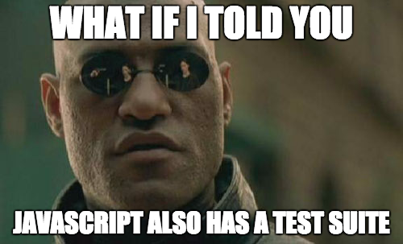

Slide 6
Jasmine Testing (Setup)
$ npm install --save-dev jasmine
$ npm install -g jasmine
$ jasmine init
Generates a spec folder in your repository
Within spec folder is support folder with jasmine.json file
Customizable Config (https://jasmine.github.io/2.3/node.html#section-Configuration)

Slide 7
Running Jasmine Tests (CLI)
Call module.exports on functions you want to test
Require files for functions you want to test in test suite
Use describe and it “blocks”
describe(“something.js”, () => {})
$ jasmine
Pangram Example!
Notes:
Blocks is used loosely, everything is a function
Can get more complex with larger code bases

Slide 8
Running Jasmine Tests (SpecRunner.html)
Javascript runs in the browser
Better visual representation of how our tests are performing
Easier to decipher error messages
Notes:
Both our source code and spec code is in Javascript
Drawbacks => Bleeding Code

Slide 9
Setting Up Jasmine Tests (SpecRunner.html)
Download Jasmine Standalone here
Move to respective directory
Remove any imports/exports added to source files and tests
src folder contains all source code, spec folder contains tests, lib folder contains jasmine code
$ open SpecRunner.html

Slide 10
One Step Further...
Can create a sinatra app with two links
SpecRunner.html
Index.html
Easily navigate between different pages of our application
Useful when writing HTML-focused JavaScript

Slide 11
Pre-defined Matchers
toBe
toEqual
toMatch
toBeNull
toBeTruthy
toBeFalsy
toContain
toBeLessThan
toBeGreaterThan
toBeCloseTo
toThrow
Exact equality (===)
Regular equality (==)
RegularExpression Matching
Null
true, {}, [], 42, “foo”, new Date()
false, null, undefined, 0, “”, NaN
Checks for element in an erray
<
>
≈
Catch Expected Exceptions

Slide 12
SpecHelper is Your Friend!
Useful for test preparation (variable assignment)
Starts with beforeEach() Jasmine helper
Can call jasmine.AddMatchers to create custom Jasmine Matchers
These are functions with a compare call with the actual and expected values as arguments
The return calls a pass key that has a boolean value to determine the function of the Matcher

Slide 13
So to recap..
TDD is important!
Jasmine uses JS functions to test JS code (which are also functions)
Can execute Jasmine tests in either terminal or browser
Tests have similar structure as RSpec model tests (describe, it)
Assortment of matchers to use
Can create custom matchers in SpecHelper

Slide 14
Useful Links
Jasmine Configuration
Jasmine Repo and Installation
Jasmine Standalone Link
Jasmine Documentation and Guides

Slide 15
Thanks!
Any questions ?
Afternoon Challenge
Quiz

